Slide 1
Vectorized Emulation
Buckle up!

Slide 2
About me
Hello, my name is Brandon Falk
Twitter is my best contact @gamozolabs
I also stream under `gamozolabs` on YouTube and `gamozo` on Twitch
Sometimes I make actual videos, would love to do more
And I write blogs at https://gamozolabs.github.io
I write a lot of exotic harnesses and fuzzers
Multiple hypervisors and operating systems for fuzzing
Emulators and JITs
Using 0-days and heavy reversing to snapshot closed-source systems
Even systems without public binaries
CPU vulnerability research (found MLPDS, wrote PoCs for almost every CPU bug)

Slide 3
Public Information on Vectorized Emulation
Introduction to the concept
Talk through the high-level goals of vectorized emulation
https://gamozolabs.github.io/fuzzing/2018/10/14/vectorized_emulation.html
MMU Design
Talking about how the MMU was designed for high-performance vectorized JIT
https://gamozolabs.github.io/fuzzing/2018/11/19/vectorized_emulation_mmu.html
“Solving” behavior
Discuss the benefits of vectorized emulation and how it explores the unknown
Blog scheduled for a later date

Slide 4
Terminology
Term | Meaning
Vector | Register containing multiple pieces of data
Lane | One single component of a vector
VM / Guest | Virtual machine, broadly used to refer to an emulated or virtualized guest. This guest has it’s own register and memory state that’s kept in an isolated environment.
Parallel | Performing the same operation on multiple pieces of data in a vector
Neighbor | Lane of another VM which is executing along side of another lane. 16 VMs execute per vector, thus each VM has 15 “neighbors”

Slide 5
What is vectorized emulation?
Emulation of multiple VMs in parallel on a single hardware thread using Intel AVX-512 instructions
Gather code coverage, memory coverage, and register coverage
Divergence/differential reduces coverage overhead
Better-than-ASAN memory protections
Perf hit due to emulation? Nope… actually faster than native
Typically 30% faster than native with full coverage, 2-3x without coverage
2 trillion emulated instructions per second (raw math targets)
100 billion emulated instructions per second (“standard” targets)
(Benchmarks from a $2k USD 64 core Knights Landing 7210)

Slide 6
Agenda
Vectorization/SIMD
What is it?
Why is it part of ISAs?
Snapshot fuzzing
How does it differ from “traditional” fuzzing?
What are the benefits?
Vectorized emulation
How do we leverage vectorization for emulation?
What does it mean for fuzzing?
Results
Does this actually work?

Slide 7
SIMD / Vectorization
A primer on SIMD

Slide 8
Single instruction, multiple data (SIMD)
MMX/SSE/AVX on x86, NEON on ARM, AltiVec on PPC, etc
One instruction performs the same operation on multiple inputs
SIMD instructions are typically the fastest way to process data on a CPU
These are the “gross” instructions you run into when reversing
`vpcmpestri`, `vpshufbitqmb`, easy on the eyes
Typically only used in math-intensive operations and research
Also useful for memory operations, `mem*()`, `str*()` libc routines

Slide 9
SIMD introduction to x86 (MMX)
Started with MMX in 1997
Added 8 new 64-bit registers, mm0-mm7
mm registers could hold one 64-bit integer, two 32-bit integers, four 16-bit integers, or eight 8-bit integers
Packed operations could be performed on the different “lanes” in parallel
The lanes are the packed smaller-than-register integers
Only integer operations with original MMX

Slide 10
Example: Adding with MMX
Packed adds can be performed with the `padd` instructions
paddb – Packed add bytes (8 x 8-bit operations)
paddw – Packed add words (4 x 16-bit operations)
paddd – Packed add double-words (2 x 32-bit operations)
paddq – Packed add quad-words (1 x 64-bit operation)

Slide 11
Example: paddw mm0, mm1
mm0
5
6
7
8
+
mm1
1
2
3
4
=
mm0
6
8
10
12

Slide 12
Why SIMD?
Performance speedup
Fewer instructions to decode
Fewer dependencies to track
All the packed adds are independent and ordering doesn’t matter
Users
Media encoding/decoding (images, video, sound, etc)
Rendering and graphics
Neural nets
Finance
… really anything with multiple streams of data to perform the same math on

Slide 13
Modern SIMD on Intel x86
SSE (1999), 8 x 128-bit registers, packed float support
SSE2, SSE3, SSSE3, SSE4, etc: More complex instructions added
AVX (2008), 16 x 256-bit registers
AVX-512 (2013), 32 x 512-bit registers
Added support for kmask registers
Neural-net specific instructions
Whopping 512 single-precision floats storable in each thread’s register file

Slide 14
Scalar vs AVX-512 performance
add eax, [rsp + 0x00]
add ecx, [rsp + 0x04] add edx, [rsp + 0x08]
add ebx, [rsp + 0x0c]
…
add r15d, [rsp + 0x3c]
vpaddd zmm0, zmm1, zmm2
1 instruction per cycle
16 instructions total
16 cycles total
Memory accesses required due to large amounts of state (16 dwords)
2 instructions per cycle
1 instruction total
0.5 cycles total
No memory access needed, data fits in register file

Slide 15
Real-world SIMD
Handwritten using intrinsics for high-performance programs
Intrinsics are 1-to-1 C/C++ implementations of assembly instructions
For example: _mm_aesenc_si128(x, y) will generate an `aesenc` instruction
Allows using high-level languages like C to write assembly-level optimizations
Often automatically generated by your compiler
Not too great compared to handwritten
Frameworks like OpenCL can be used to help write C and benefit from CPU/GPU scaling

Slide 16
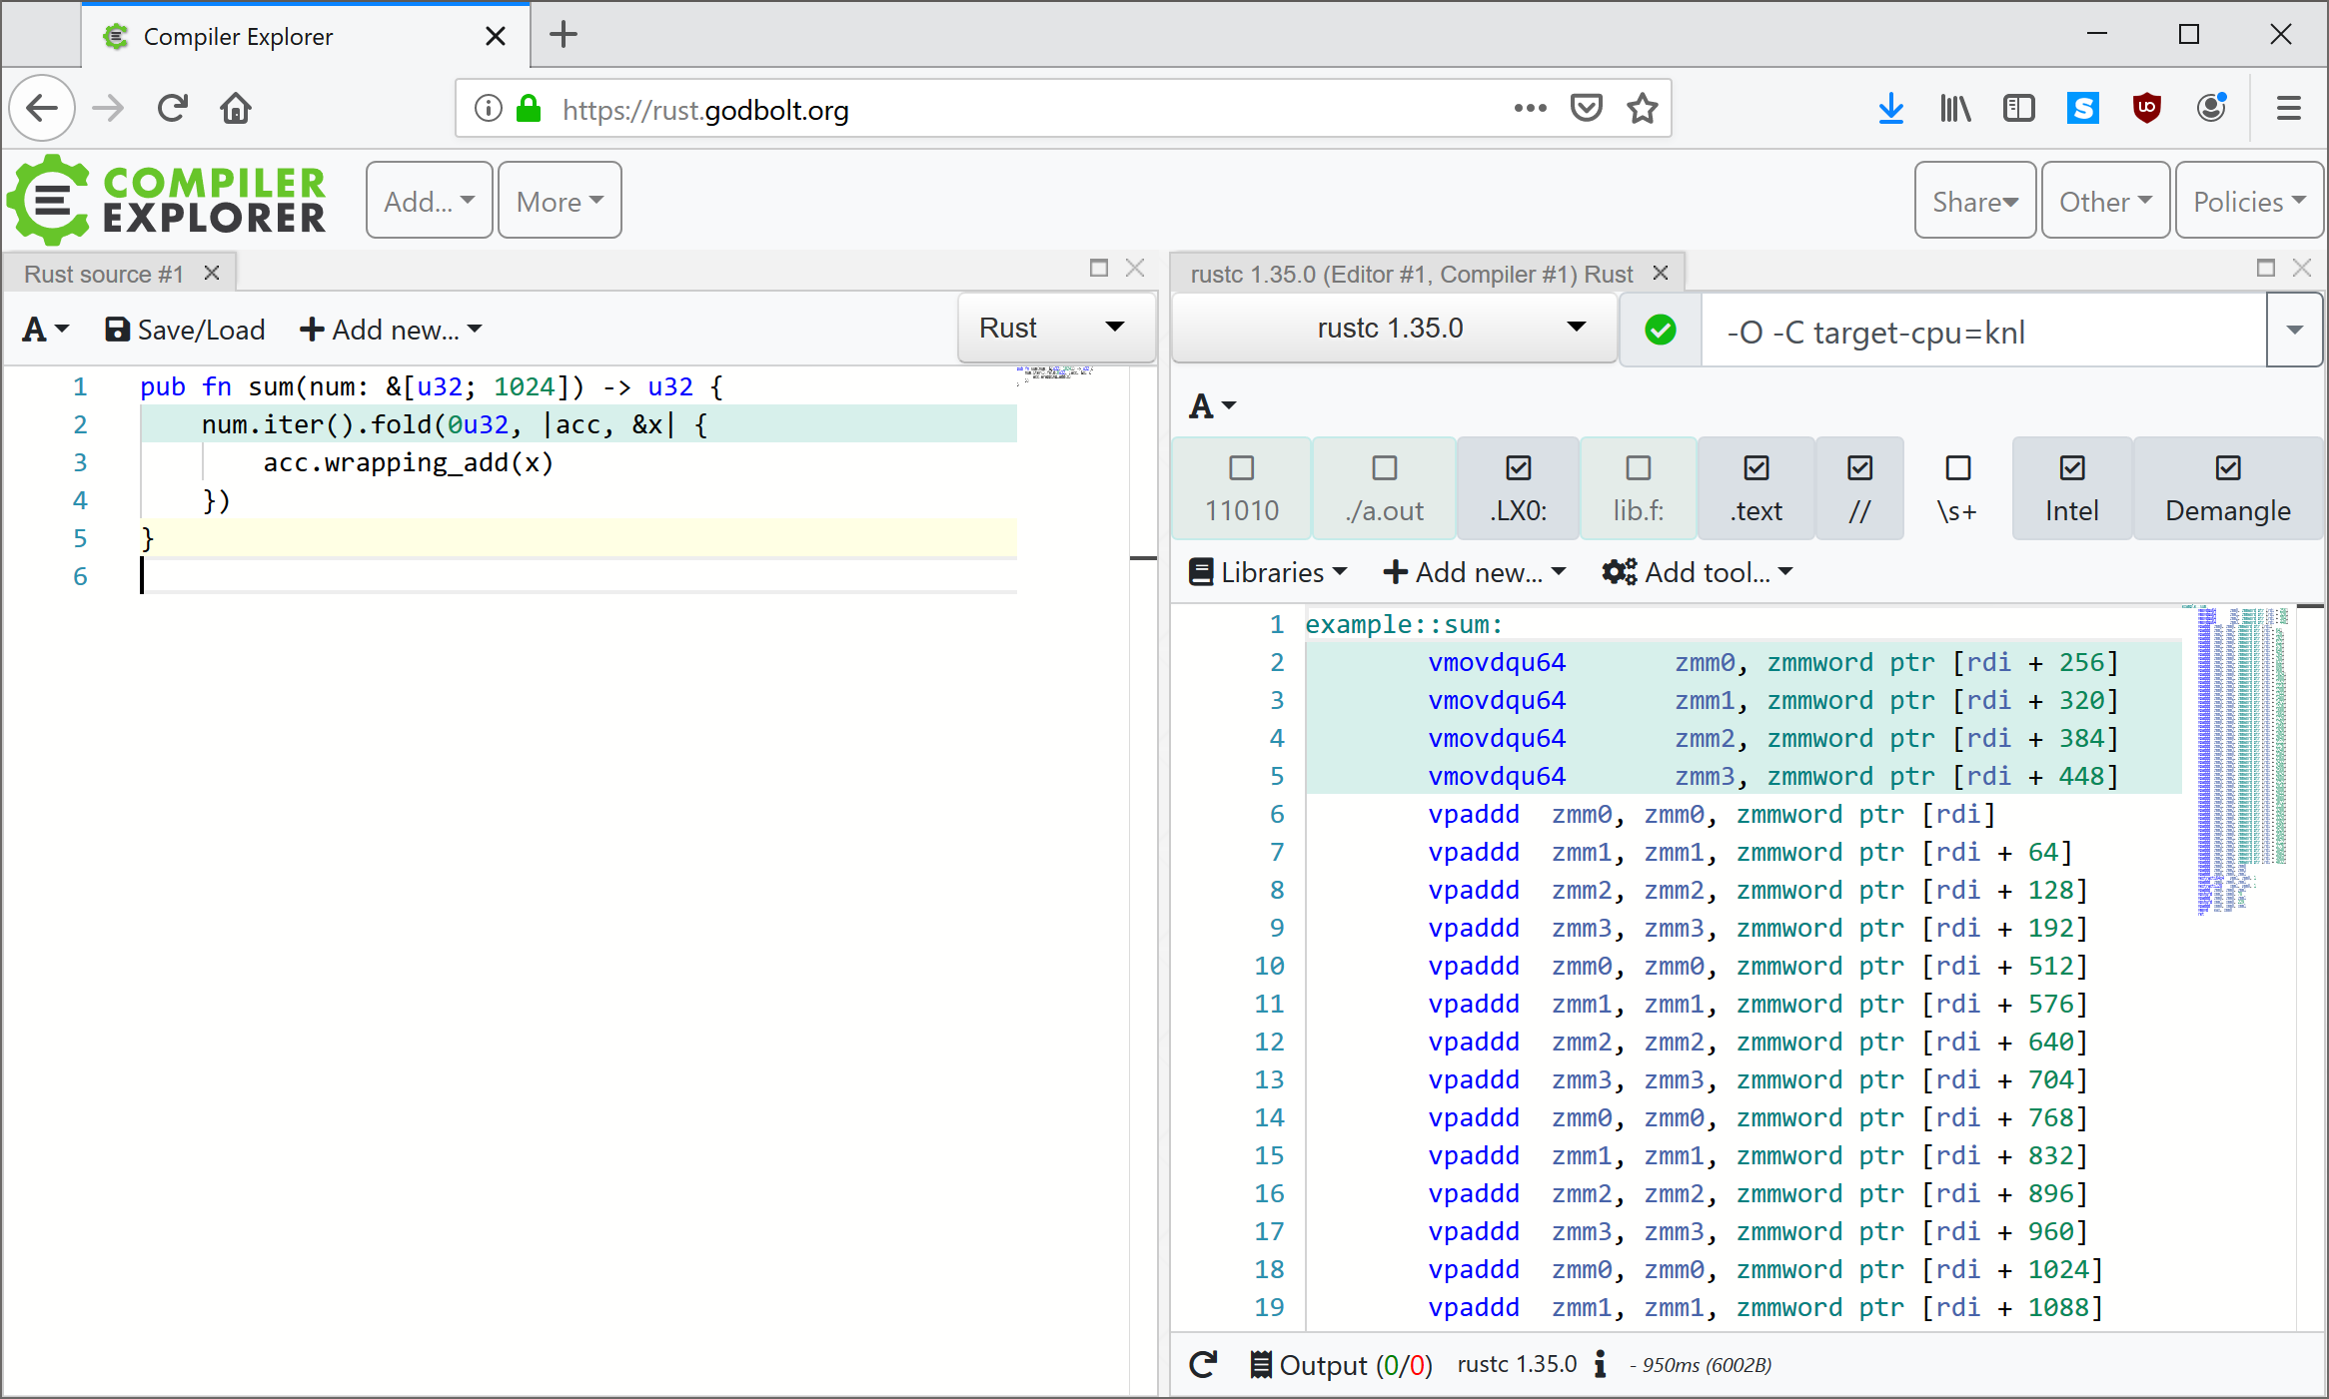

Slide 17
Snapshot Fuzzing
Deterministic and focused fuzzing

Slide 18
Snapshot Fuzzing
Fuzz cases start with memory and register state
Registers and memory are reloaded to the saved state
User-controlled inputs are modified in memory
Execution is resumed from this snapshotted point
When a fuzz case ends, the state is restored
Often differentially, where only modified memory is restored

Slide 19
Why Snapshot Fuzzing?
Skip application startup times
Allows for easier emulation of hard-to-emulate targets
Take a snapshot on an iPhone, continue execution in emulation
Fully deterministic, or at least higher levels of determinism
Application continues from the same state each fuzz case
Same fuzz input should give the exact same result
Comparing different inputs to the same snapshot is an apples-to-apples comparison
Any difference in execution is due to the user input, not unknown program state

Slide 20
Determinism
My #1 priority, even if there’s a performance regression
Same input should produce the exact same result
Same memory accesses, register values, program flow, etc
Never have a crash that cannot reproduce
Any new coverage is due to the change made in the input
The only variable is the input to the program, all other state is constant
Easier to A-B test fuzzer performance
Modify fuzzer, see if it gets crashes faster or more coverage
If it did, the change made to the fuzzer were likely an improvement

Slide 21
Snapshot Fuzzing Difficulties
Not always easy, per-target harnessing to take a snapshot
Sometimes an 0-day is required to take a snapshot, especially on locked-down devices
Snapshot must be “atomic”, memory cannot be changing during snapshotting
Custom devices may need to be emulated
Higher upfront cost, lower fuzz costs
Honestly… never really had a problem doing snapshot fuzzing on a wide variety of targets

Slide 22

Real-world example
Snapshot fuzzed Word RTF in 2013 using falkervisor
Reversed where Word loaded up files
Had some C++ class which cached accesses to files
Placed breakpoint after first NtReadFile() which read the input file
When breakpoint is hit, all of physical memory and register state is saved
This state is re-created in a new VM when fuzzing
Input just read from disk is modified in memory
Fuzzer runs until termination (timeout, crash, parsing complete, etc)
VM is reset differentially to the original state, and a new case starts!

Slide 23
Real-world Results
4,000 fuzz cases per second fuzzing Word on a 64-core machine
Deterministic crashes
All bugs reproduced and thus triage was much easier
Inputs could be automatically minimized
Randomly delete sections of bytes from the input file
Same crash? Save the new input, continue
No crash, different crash? Revert to the last-known-crashing input
250 KiB input RTFs minimized down to 50-80 bytes in 15-20 seconds
Over 30 unique bugs, 10+ RCE bugs
Spent most human time doing triage
About 30-40% of the bugs lasted for more than 5 years

Slide 24
Vectorized Emulation
The concept, limitations, and overcoming those limitations

Slide 25
Vectorized Emulation Summary
Using Intel’s AVX-512 instructions to emulate multiple VMs in parallel on a single hardware thread
Each lane of the vector register belongs to a separate VM
Allows for faster-than-native emulation of targets
High-performance fuzzing of non-x86 targets on x86 hardware
Only useful with snapshot fuzzing
Need to have VMs sharing the same code paths

Slide 26
Why is this a thing?
I really wanted to get my hands on a Xeon Phi
So I bought one… had to justify it while it was shipping
Couldn’t use it for falkervisor as Knights Landing does not have VT-x
At least the memory bandwidth is fast, might be useful for emulation?
Same code bring run on multiple VMs?
Should be able to vectorize when VMs run in lockstep

Slide 27
What would this look like in a simple case?
Let’s say you are emulating MIPS32 and executing an `add t0, t1, t2`
This adds the `t1` and `t2` registers and stores them into `t0`
Can we represent this using vector instructions?
`vpaddd zmm0, zmm1, zmm2`
Where `zmmX` holds 16 register states for the corresponding target registers `tX`
Well that was pretty easy
Assign target architecture registers to `zmm` registers
Each `zmm` now holds 16 32-bit VM states in parallel

Slide 28
Would this actually work?
If all VMs execute the exact same code… this always works
For anything meaningful, the VMs will do slightly different things
What happens on differing register states?
What happens on a memory access?
What about branches?
What about conditional branches?
Could have an input-influenced conditional branch
Now there is divergence between VMs

Slide 29
Getting same code execution in VMs
Since we’re using snapshot fuzzing, each VM starts in an identical state
All memory is the same
All registers are the same
With the same input all VMs will do the exact same logic
Would never have divergence in code flow
All code would be vectorized
No worries about differing memory accesses
Even if there is divergence, we can parallelize initialization code
Was the initial goal of vectorized emulation

Slide 30
What about differing register states?
Doesn’t actually matter
Two VMs executing same code with different register states
SIMD instructions don’t care about the data
`vpaddd` will perform the add on all the register states for the VMs, regardless of the register states

Slide 31
Memory accesses?
Two VMs use the same instruction to access different memory
Perform a page-table walk in parallel and resolve to different memory
Read/write the memory in parallel
Not really a problem, just extra code

Slide 32
Branches?
Just like any other JIT
Some way to look up target addresses in a table
If they’re not already JITted, then lift the target branch and insert it into the table
From this point on the lifted target is now in the target JIT table
Target JIT table just translates target addresses to host addresses which contain the JITted code for the corresponding target code

Slide 33
Divergent branches?
Oh… this one is actually hard
User-controlled input caused two VMs to execute different code
Cannot continue executing in parallel because different operations are now being performed?
For example, one VM goes to perform a `sub` instruction, and the other goes to perform an `add` instruction
All hope is lost?
Nope, kmasks to the rescue

Slide 34
AVX-512 kmask registers
Intel’s AVX-512 introduced 8 new registers, `k0` through `k7`
These mask registers can be used with any vector operation
Used to indicate which lanes to perform the operation on
Can be used in merging (preserve) or zeroing modes

Slide 35
AVX-512 kmask zeroing example
mov k1, 0b0110
vpaddq ymm0 {k1}{z}, ymm1, ymm2
ymm1
5
6
7
8
+
ymm2
1
2
3
4
=
ymm0
0
8
10
0

Slide 36
AVX-512 kmask merging example
ymm0
31
3
3
7
ymm1
5
6
7
8
+
ymm2
1
2
3
4
=
ymm0
31
8
10
7

Slide 37
Making divergence possible
Emit AVX-512 kmasks for every JITted instruction
Maintain a kmask which has bits set for VMs which are executing the same code
As a VM diverges, clear the corresponding bit in the kmask
Now that VM will not be updated while other VMs execute code
Come back to execute the VMs which were masked off at a later point
Different ways to “come back” to VMs
Post-dominator in the graph
When the fuzz cases end
Never bring them back

Slide 38
Any more potential issues?
None that I’m aware of at this point
Let’s go actually write this!

Slide 39
wafflecone
A 32-bit vectorized emulation implementation using Intel AVX-512

Slide 40
Components of wafflecone
Lifters
Converting x86/ARM/MIPS/etc to FalkIL
Intermediate language (FalkIL)
Generic representation for all architectures
Optimization passes and debug information to recover target state
FalkIL Interpreter
JIT
Taking FalkIL instructions and generating AVX-512
FalkMMU
Providing an isolated memory space for the emulated target
Not the most visually appealing program…

Slide 41
New coverage => 00019d25
New coverage => 000198a8
vmid 0 Got crash 1337000b
Input was "229 n aZ(
"
eax 00000001 ecx b4230000 edx b4231030 ebx 0000000d
esp b4232f80 ebp b4232fe0 esi 13370009 edi b4231030
eip 00019a5e
vmid 0 Got crash 1337000b
Input was "229 �(
"
eax 00000001 ecx b4230000 edx 1337000b ebx 0000000d
esp b4232f80 ebp b4232fe0 esi 1337000b edi b4231030
eip 00019aaa
New coverage => 0001a34f
New coverage => 0001a386
uptime: 11.53 | case 778152176 | drops 1342706 | vfactor 15.9724 | fcps 77,768,824.3584 (theo 615,241,609.0636)
Restore: 0.1261 Feedback: 0.0243 Fuzz: 0.4980 VM: 0.1264 Analysis: 0.0725 Accounted cycles: 0.9358
Cov: 80 Inputs: 13121
Lifted instrs executed: 28939693248 | gips: 25032374569.55 | Avg instrs/case: 37.19 | Theo speedup 2.6869
Exit reason (VirtAddr(0xdeaddead), Branch(VirtAddr(0xdeaddead)))
Exit reason (VirtAddr(0x00019aaa), MemoryFault(ReadFault(VirtAddr(0x1337000b))))
Exit reason (VirtAddr(0x00019a5e), MemoryFault(ReadFault(VirtAddr(0x1337000b))))

Slide 42
Lifting target code
Started with MIPS32, added PPC, ARM, x86 support later
MIPS32 is just easier to get correct for proving the concept
Snapshot was taken on a real target
Read the memory containing the instruction pointed to by PC
Decode the instruction
Lots of time spent reading architecture manuals
Implement the behavior of the instruction in an intermediate-language (IL)
This IL must provide all required operations to implement all target instructions

Slide 43
FalkIL
Simple intermediate language designed for emulation
Goal is that a new JIT or emulator implementation should take less than a day
Allows for trying things out
IL not designed for human readability
Ended up being about 15-20 instructions
Add/sub/bitwise operations
Conditional branch
Conditional set register
Flagless
SSA IL

Slide 44
FalkIL Continued
RISC-like IL
No immediates on instructions
Only a load immediate instruction
Only aligned reads and writes allowed
Explicit load/store architecture
All arithmetic instructions operate only on registers
Metadata maintained to associate IL registers with target registers
Basic optimization passes to help fuzz unoptimized code
DCE, constant propagation, deduplication, etc

Slide 45
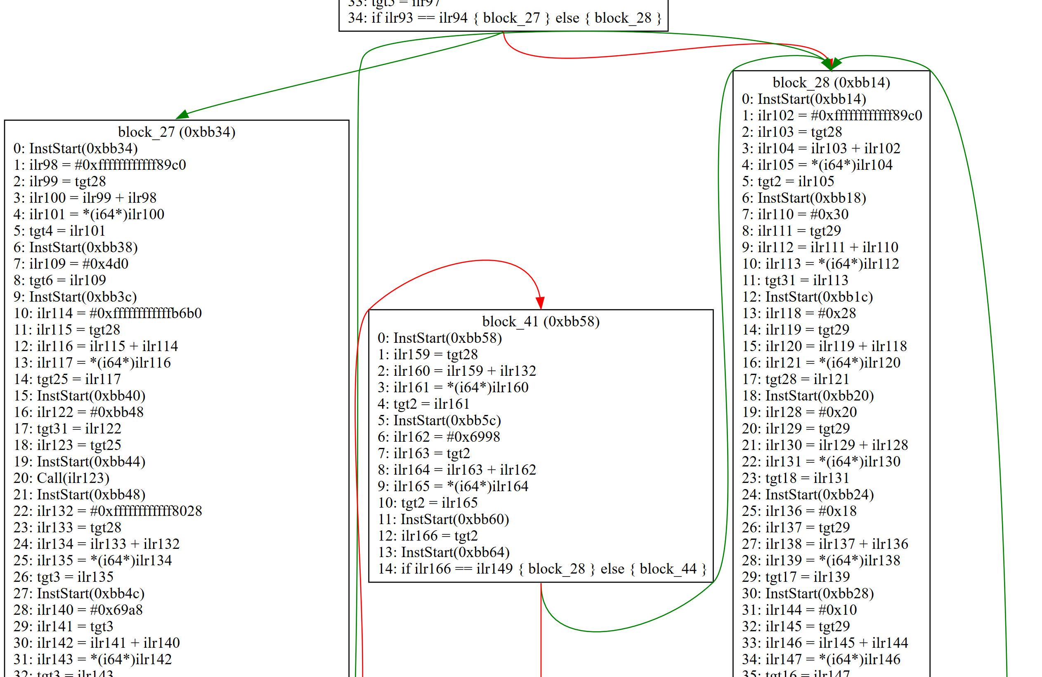

Slide 46
JIT
Simple template-based JIT
Each IL instruction has a template for x86 vectorized code that has the same semantics
Every x86 instruction emit must have a kmask
All JIT must respect the kmasks
Bits clear in the kmask must result in no changes to the corresponding lane’s register or memory state
Dynamic register allocation using a mix of `zmm` registers and memory

Slide 47
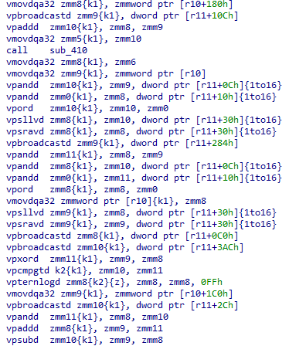
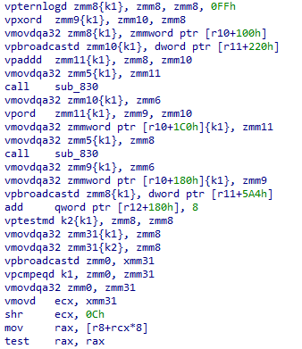

Slide 48
MMU
Guest memory must be organized in a way that can be vectorized
Guest memory must be isolated from host memory
Simple software page table. JIT walks the page table on accesses
Optimized for all VMs accessing the same address
A `vmovdqa` instruction will load a 512-bit location in memory
Scatter/gather instructions are much more expensive
Interleave memory on 32-bit boundaries
Now if all VMs access the same address a `vmovdqa` can be used to load/store for all VMs with only one translation
Divergent loads/stores (differing addresses per VM) must go through a parallel page table walk

Slide 49
mask 0 1 2 3
Permissions 100000000000 : 0303030303030303 0303030303030303 0303030303030303 0303030303030303
Contents 100000000000 : 34c0414141414141 34c1414141414141 34c2414141414141 34c3414141414141
Permissions 100000000008 : 0303030303030303 0303030303030303 0303030303030303 0303030303030303
Contents 100000000008 : cccccccccccccc56 cccccccccccccc56 cccccccccccccc56 cccccccccccccc56
Permissions 100000000010 : 0303030303030303 0303030303030303 0303030303030303 0303030303030303
Contents 100000000010 : 414141414141cccc 414141414141cccc 414141414141cccc 414141414141cccc
Permissions 100000000018 : 0303030303030303 0303030303030303 0303030303030303 0303030303030303
Contents 100000000018 : 4141414141414141 4141414141414141 4141414141414141 4141414141414141
Permissions 100000000020 : 0303030303030303 0303030303030303 0303030303030303 0303030303030303
Contents 100000000020 : 4141414141414141 4141414141414141 4141414141414141 4141414141414141
Permissions 100000000028 : 0303030303030303 0303030303030303 0303030303030303 0303030303030303
Contents 100000000028 : 4141414141414141 4141414141414141 4141414141414141 4141414141414141
Permissions 100000000030 : 0303030303030303 0303030303030303 0303030303030303 0303030303030303
Contents 100000000030 : 4141414141414141 4141414141414141 4141414141414141 4141414141414141
Permissions 100000000038 : 0303030303030303 0303030303030303 0303030303030303 0303030303030303
Contents 100000000038 : 4141414141414141 4141414141414141 4141414141414141 4141414141414141
Permissions 100000000040 : 0303030303030303 0303030303030303 0303030303030303 0303030303030303
Contents 100000000040 : 4141414141414141 4141414141414141 4141414141414141 4141414141414141
Permissions 100000000048 : 0303030303030303 0303030303030303 0303030303030303 0303030303030303
Contents 100000000048 : 4141414141414141 4141414141414141 4141414141414141 4141414141414141
Permissions 100000000050 : 0303030303030303 0303030303030303 0303030303030303 0303030303030303
Contents 100000000050 : 4141414141414141 4141414141414141 4141414141414141 4141414141414141

Slide 50
MMU Hardening
We want ASAN/uninitialized protections
Every byte of guest memory has a byte of permissions
Permission byte has explicit read, write, execute, and RAW bits
Out-of-bounds access by 1-byte causes a fault
Technically stronger than ASAN
Read-after-write (RAW) bit
Set if memory should be readable, but only after it has been written once
New allocations in the guest set as RAW
Fault will occur if the memory is read before written
Uninitialized memory use detection, with byte-level granularity

Slide 51
Code Coverage
With a JIT code coverage is easy
Code is only ever JITted when it’s hit
Code coverage is just the size of the JIT database
Might need custom hooks if PC/edge/block/graph coverage is desired
For finer-grained coverage just emit JIT to update a global bitmap

Slide 52
Differential Coverage
Only saving coverage based on user-controlled divergence

Slide 53
Horizontal Comparison
Running with 16 other VMs in parallel
Can cheaply “look to your neighbor” to determine if you’re doing something new
On conditional and indirect branches, check what your neighbors are up to
If they’re going somewhere else than where you are, something changed in the input caused this change
Save the input for future use
With a smart fuzzer, prioritize the operation you performed as a meaningful one
Associate changes and mutation strategies with what they affected in the program state

Slide 54
Horizontal Comparison Implementation
ymm0
1
4
3
4
Broadcast bottom word of ymm0 to ymm1
ymm1
4
4
4
4
Vector compare between ymm0 and ymm1 into mask k2
k2
0
1
0
1
If k2 is not equal to the online mask, user input influenced this value!

Slide 55
Memory/Register State Coverage
Typically not feasible due to storage overhead
Need to log every register on every instruction
Track unique register and memory states observed during fuzzing
Just like code coverage, but tracking program states
Goal is to get coverage information for state machines
Same code, different states, potentially crashes in “common” code paths
Vectorized Emulation makes it feasible
On register/memory loads/stores look to your neighbors
If they have a different value, log the input as a new one
Coverage is only gathered on instructions which user input influences
No tracking register state on uncontrolled `printf()` state

Slide 56
Divergent Coverage
Only store coverage information when it was caused by user-inputs
Coverage databases only hold user-controlled branch information
Reduces memory required to store databases
More meaningful information for human consumption
Can track when user-controlled data affected a register state or memory state
Don’t know “why” it was affected, but you know that it was
Can color IDA to show hit code, influenced register writes, and influenced register reads

Slide 57
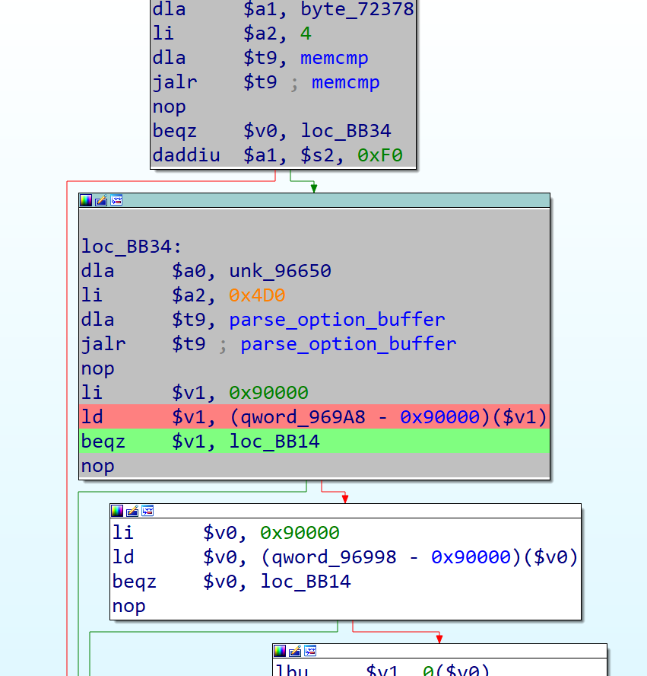
Divergence

Slide 58
Results

Slide 59
Results
Sadly limited usage
I’ve just been busy
Fuzzed Windows and OpenBSD DHCP servers and client
Trillions of fuzz cases per week in each
Over 20 unique bugs in Windows DHCP
6+ RCE bugs
Re-finds all 20 bugs in under 5 minutes of runtime
1 silly OpenBSD bug
Out-of-bounds read in the highest level for loop
Almost always incorrect
Wouldn’t have found without byte-level
1 remote bluescreen in Windows Firewall code

Slide 60
Solving-like Behavior
Register and memory coverage with feedback yields… strange results
Un-enlightened byte-flipper can find valid inputs
let fuzz_input = corpus.random_input();
for _ in 0..rng.xorshift() % 4 {
let offset = rng.xorshift() % fuzz_input.len();
let byte = rng.xorshift() as u8;
for vmid in vm.online() {
let fuzz_input = &mut fuzz_input[vmid];
fuzz_input[offset] = byte.wrapping_add(vmid as u8);
}
}

Slide 61
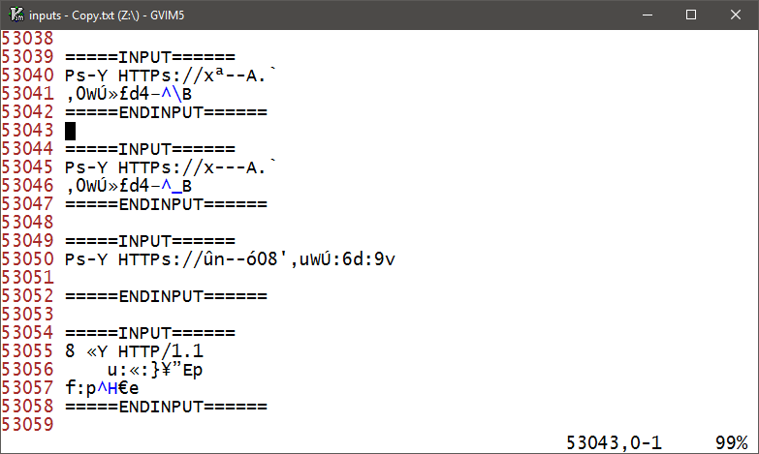

Slide 62
Stress testing coverage
Created Hellscape, a proving ground for coverage guided fuzzers
https://github.com/gamozolabs/hellscape
Has multiple bugs reachable with coverage guided fuzzers
Branch-per-byte-comparison (findable with code coverage, AFL)
memcmp()-like comparison (register coverage)
Multiple memcmp()-like comparison (path based register coverage)
Batched memcmp()-like comparison (register coverage, word shattering)
Multiple batched memcmp()-like comparison (path based register coverage, word shattering)
All bugs should be findable with a byte flipper, no enlightenment
wafflecone finds all 5 bugs in under a second

Slide 63
Conclusion

Slide 64
Should you use vectorized emulation?
Probably not
It’s too fast
For small targets it runs over a million fuzz cases per second
Getting meaningful fuzz inputs a million times a second is a hard problem
Probably better things to do with your time
Switch to a coverage-guided fuzzer
Use coverage in a meaningful way
Write a new fuzzer to the specification you’re fuzzing
Audit code!
Switch to snapshot fuzzing
Still have done all of these things? Still need more bugs? Okay maybe use vectorized emulation

Slide 65
Questions?

